Slide 1
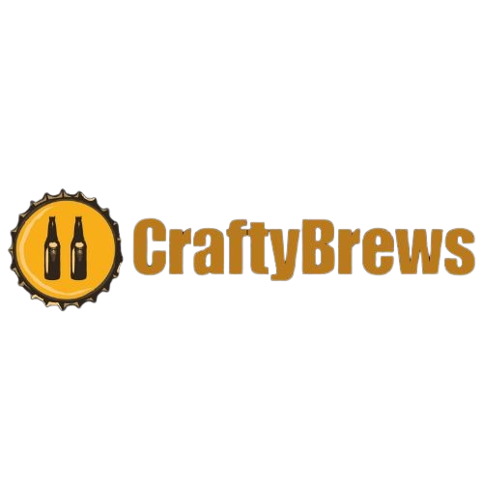

Maximizing Returns: Profit Optimization Strategies at Crafty Brews Brewing Company
Team 390 NexusBlend |
Ganesh Apparaju, Sai Karun Reddy Gaddam, Minghao Liu, Xuanyu Wang, Jason Chang
Notes:
As we begin this presentation, we explore how Crafty Brews Brewing Company successfully maximizes their returns. We'll see how they combine their brewing methods with strategic market tactics to optimize profits in the dynamic world of craft beer.

Slide 2





MEET OUR TEAM
Xuanyu Wang
Ganesh Apparaju
Minghao Liu
Jason Chang
Sai Karun Reddy Gaddam
Notes:
We the nexusblend, we are a group of business analysts working on this project for CraftyBrews

Slide 3

Crafty Brews Brewing Company Strategic Overview
Who They Are?
An innovative craft beer producer serving a diverse clientele across bars, restaurants, and retail stores committed to optimizing its production and distribution strategies.
What They Offer?
A rich selection of craft beers including IPA, Stout, Lager, Pilsner, Wheat Beer, and Saison, each with strategic pricing and production planning.
Why We Optimize?
To enhance profitability, accommodate client tastes, manage resources effectively, and deliver fresh products without the need for inventory storage.
Notes:
Let’s breakdown the strategic overview of CraftyBrews
So who is CraftyBrews? Crafty Brews Brewing Company excels in producing diverse craft beers, serving bars, restaurants, and retail stores. Their key focus? Efficient production and distribution. They offer a wide range selection of craft beers, each with different strategic pricing and production planning. Their goal is to bboosting profitability and satisfying diverse customer preferences, while ensuring fresh, inventory-free product delivery.

Slide 4
Pricing, Production, and Logistics
Beer Selection & Pricing
Detailed pricing structure for each client type.
Example: IPA priced at $4.10 for bars, $3.60 for restaurants, and $3.10 for retail stores.
Production & Costs
Costs associated with brewing each beer type, such as $1.55 per unit for IPA and $1.75 for Stout.
Maximum brewing capacities to ensure a balanced production aligned with market demand.
Budget & Transportation
Operating under a weekly budget of $105,000 for brewing and transportation.
Fleet of trucks with varying costs and capacities for efficient distribution.
Delivery & Receiving Capacity
Client-specific delivery requirements and maximum capacities, such as 20,000 for bars, 17,000 for restaurants, 28,000 for retail stores weekly.
Emphasis on no inventory holding, ensuring fresh delivery.
Notes:
Lets dive into CraftyBrews s strategic approach to pricing, production, and distribution. They've established a detailed pricing structure tailored to different client types.
And In production, they maintain cost-effectiveness, ensuring profitability while aligning with maximum brewing capacities to meet market demand. Lastly, delivery and receiving are tuned to client needs with specific capacities, ensuring fresh delivery without the need for holding inventory. This approach exemplifies Crafty Brews' commitment to strategic planning and market responsiveness.

Slide 5
Key problem areas to be addressed
01
Exploring Strategies for Maximizing Weekly Profits at Crafty Brews
Understanding the relationship between multiple factors such as pricing strategies, production costs, distribution strategies in the context of capacity constraints to optimise profit
02
Identifying the Peak Profit Potential for Crafty Brews: Understanding the Weekly Earnings Ceiling within Current Constraints
This approach is crucial in aligning production with market demand, ensuring that Crafty Brews efficiently meets consumer preferences each week.
By optimizing the production volume for each type of beer, Crafty Brews can effectively manage resources, reduce waste, and maximize revenue, directly impacting the bottom line.
03
Strategies for Balancing Minimum Order Requirements and Profit Maximization at Crafty Brews: Meeting Client Needs Efficiently
Enhanced Client Satisfaction and Loyalty
Optimal Resource Allocation for Increased Profits
04
Identifying the Ideal Beer Portfolio for Crafty Brews
Tailoring Production and Distribution to Bars, Restaurants, and Retail Stores for Preference Satisfaction and Profit Maximization
05
Crafting an Effective Budget Strategy for Crafty Brews to Optimize Brewing and Delivery Operations
Increased Efficiency: Proper budget allocation enhances operational efficiency in brewing and delivery processes.
Cost Savings: Strategic financial management leads to reduced unnecessary expenses and maximizes profit margins.

Slide 6
Measures to consider:
Variables:
Beer type i: IPA, Stout, Lager, Pilsner, Wheat Beer, Saison
Client j: Bars, Restaurants, Retail stores
Trucks to use k: Small, Medium, Large
Price & Cost:
Selling price for beer type sold in each type of client: Pij
Cost of transporting using each type of truck: Tk
Brewing cost for producing type i beer: Ci

Slide 7
Capacity:
Brewing capacity for each type of beer: Fi
Transporting capacity for each type of truck: CTk
Delivery capacity for each type of client: Dj
Requirements & Limits:
Maximum number of beer to ship to each type of clients: Mxi
Maximum number of truck to use: Nk
Maximum amount of money to spend: B - Budget
Minimum number of beer to ship to each type of clients: MNi

Slide 8
Decisions Variables:
The decision of determining whether to delivery beer i to client j: Xij
The decision of determining the quantity of each type of beer to export to each client: Yij
The decision of assigning the quantity to transport for each type of truck: Zk

Slide 9
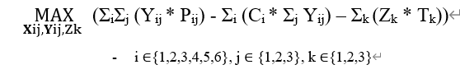
Objective function
Produce Cost
- i {1,2,3,4,5,6}, j {1,2,3}, k {1,2,3}
Revenue
Shipping Cost

Slide 10
Basic Constraint
1. Xij ∈ {0,1} - Binary Constraint
2. Yij ≥ 0 - Non-negative shipping
3. Yij ∈ {Integers} - Number of bottles should be integer
4. Zk ≥ 0 - Non-negative transportation

Slide 11
Essential Constraint
1. (Σi (Ci * Σj Yij) + Σk (Zk * Tk)) ≤ B, Budget Constraint – Total cost cannot cross total budget
2. Σj Yij ≤ Fi , i ∈{1,2,3,4,5,6}, Brewing Capacity Constraints per Beer type ‘i’
3. Σi Yij ≤ Dj , j ∈{1,2,3} , Delivery Capacity Constraints for Client ‘j’

Slide 12
Essential Constraint
4. MNj ≤ Σi Xij ≤ MXj , j ∈ {1,2,3}, Number of types of beers to be sent to client ‘j’ should be in the specified limits.
5. Yij ≤ M * Xij, Connecting Yij and Xij – M is a large number (logic constraint)
6. Σk Zk = ΣiΣj Yij, Total number of bottles transported using all truck types should match total number of bottles shipped to each client.
7. Zk ≤ CTk * Nk, k ∈{1,2,3}

Slide 13
DECISION VARIABLES
Decision Variables
Binary decision
Beer Type | Bars | Restaurants | Retail Stores
IPA | 1 | 0 | 1 |  | connecting x and y
Stout | 0 | 0 | 1 |  | 100000000 | 0 | 100000000
Lager | 0 | 0 | 1 |  | 0 | 0 | 100000000
Pilsner | 0 | 1 | 0 |  | 0 | 0 | 100000000
Wheat Beer | 0 | 1 | 1 |  | 0 | 100000000 | 0
Saison | 1 | 0 | 0 |  | 0 | 100000000 | 100000000
Total | 2 | 2 | 4 |  | 100000000 | 0 | 0
CONSTRAINTS
MIN | 2 | 2 | 4
MAX | 4 | 4 | 6
Quantity to export
Beer Type | Price for Bars | Price for Restaurants | Price for Retail Stores | Total_beertype |  | Max Capacity
IPA | 10500 | 0 | 2000 | 12500 | <= | 12500
Stout | 0 | 0 | 5525 | 5525 | <= | 12000 | slack
Lager | 0 | 0 | 10000 | 10000 | <= | 10000
Pilsner | 0 | 12000 | 0 | 12000 | <= | 12000
Wheat Beer | 0 | 5000 | 6500 | 11500 | <= | 11500
Saison | 9500 | 0 | 0 | 9500 | <= | 9500
Total_client | 20000 | 17000 | 24025 | 61025
 | <= | <= | <= |  |  | 67500 | Max brew capacity
Max | 20000 | 17000 | 28000 |  | 65000
 |  |  | slack |  | max shipping capacity
WHETHER TO SHIP A BEER TYPE TO A CLIENT: Xij
THIS TABLE CONNECTS
Xij and Yij
HOW MUCH TO SHIP TO A CLIENT : Yij

Slide 14

DECISION VARIABLE
HOW MANY TRUCKS OF EACH TYPE
Transportation type | quantity |  | MAX CAP
small truck | 16025 | <= | 20000 | slack
medium truck | 24000 | <= | 24000
large truck | 21000 | <= | 21000
total | 61025
Production cost | $96,093.75
Delivery Cost | $8,905.00
Total Cost | Max Budget
$104,998.75 | $105,000.00
Total revenue
$219,582.50
TOTAL PROFIT | $114,583.75
PROFIT
OPTIMAL SOLUTION

Slide 15



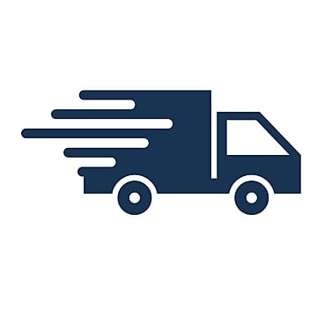

Recommendations
How can Crafty Brews optimize its production and distribution strategy to maximize weekly profit while considering pricing, production costs, and capacity constraints?
Prioritize production and distribution of the most profitable beer varieties: Saison, wheat beer, and IPA.
Focus on supplying primarily to bars, as they are the most profitable clients, followed by restaurants and retail stores.
What is the maximum profit Crafty Brews can achieve each week under the given constraints?
Crafty Brews' optimal weekly profit under current constraints is $114,583.75.
This profit is attainable by producing specific quantities of beer: 9500 bottles of Saison, 11500 of Wheat beer, 12500 of IPA, 5525 of Stout, 12000 of Pilsner, and 10000 of Lager.
How can Crafty Brews meet the minimum order quantities for each client type while maximizing profit?
Crafty Brews should prioritize bar deliveries to fulfill minimum order requirements and maximize profitability, with restaurants and retail stores following in priority.
Utilize different truck sizes for deliveries: large trucks for bars and medium trucks for restaurants, optimizing delivery efficiency for each client type.
Which beer types should Crafty Brews produce and deliver to bars, restaurants, and retail stores to satisfy their preferences and maximize profit?
Crafty Brews should produce and deliver the following beer types to bars, restaurants, and retail stores:
• Bars: Saison and IPA
• Restaurants: Wheat beer and pilsner
• Retail stores: IPA, Stout, Lager, and Wheat Beer
How should Crafty Brews allocate its budget for brewing and delivery to optimize its operations?
Crafty Brews should allocate its budget approximately for brewing and delivery in the following way:
Brewing: 90%
Delivery: 10%

Slide 16
Additional Recommendations
Retail stores : slack condition. Reason: lower profit margins. Crafty Brews should prioritize deliveries to bars followed by Restaurant as it is profitable and met boundary condition.
Saison, wheat beer and IPA are the most profitable beer types. Crafty Brews should prioritize producing and distributing these beer types.
Stout also has high profitability, but solver solution shows stout has a slack. So, the company should try to produce less of these
Large trucks are the most efficient transportation method. Small trucks are less efficient. So, they should be used only to meet the requirement constraint, and also whenever the shipment size is small.

